Slide 1



Violence Prevention
Prioritize high risk (not “hopeless”) cases for treatment
Jennifer L. Skeem
Marquette Violence Symposium: June 2019

Slide 2


Addressing two myths to maximize crime reduction
Myth 1: Qualitatively different
Myth 2: Untreatable
People at risk for repeated involvement in violence are a qualitatively different from people at lower risk
These high risk people cannot be effectively treated to prevent violence
Notes:
Adolescence has become a period of interest for justice, education, and public health policy over recent years. *There is speculation this is a potential “sensitive period” for social-emotional learning, given significant brain plasticity—where experience, education, and interventions powerfully shape trajectories toward adulthood.
About ¾ of talk- what I have done (part 1); rest; what we’re doing now (Part 2)
UNICEF- “age of opportunity”; Lancet commission → “new agenda for adolescent global health.” World Bank, others, investing billions in these efforts.
Why? In part, because advances in neuroscience have shown us that that this is a developmental period of enormous brain plasticity—the onset of adolescence sets off a cascade of changes in the brain and body—all of which occur within the context of enormous social changes, with an increased focus on peers, romantic relationships, and establishing one’s identity apart from that of the family.

Slide 3
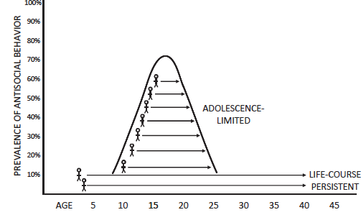
Traditional view of high-risk people
One small, unique, invariant group
Similar (not =to):
Early onset
Serious & violent
Psychopathic/CU
(Moffitt, 1993)
Notes:
Age-crime curve- prevalence/risk is limited to adolescent years.
In 1993, Terrie Moffitt offered a theory that the curve doesn’t describe ALL people … only a subset. The theory has gotten decades’ worth of research, attention, and some support.
She posited AL (maturity gap- peer processes that involve mimicry of ASB) vs. LCP (neuro impairments, familial risk)
AL – has been adopted as inspiration for the modern juvenile justice reform movement. In Larry Steinberg’s model, an increase in stimulation seeking around adolescence, combined with slower development of inhibitory controls can result in risky behavior, including crime. Leading reforms in juvenile justice, which recognize that most kids are less culpable for risky behavior by reason of adolescence.
LCPs have been implicitly carved out of this developmental explanation. As Lipsey noted, “high-risk juveniles are assumed to be “the most hardened and least likely to respond to treatment—and perhaps the best suited for adult criminal sanctions.”
From a policy viewpoint, this dichotomy offers a pretty dim perspective. Psychology today: “Adolescence limited will age out of crime …. Life-course persistents will continue to commit crime their entire lives because they are genetically inclined to do so”
Little empirical basis

Slide 4
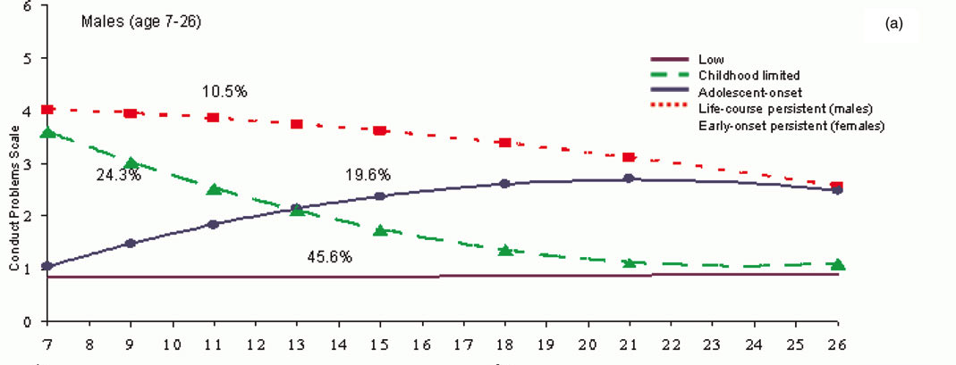
Epidemiological evidence of variance
Early onset more likely to desist than persist
Dunedin data: Odgers et al (2008)
Notes:
…epidemiological research from Moffit’s own lab. You see here the most famous study, the Dunedin study by Moffit and Caspi. Walk through graph.
See the two groups of interest—AL and LCP. BUT…
CHILDHOOD LIMITED. Convergent with other evidence that 50-70% of individuals with childhood onset conduct problems outgrow these problems by adolescence. **Childhood limited and LCP cannot be distinguished by childhood risk factors.**
ADOLESCENT ONSET. Still have conduct problems at age 26 (last wave they were assessed at); indeed, they converge with the “LCP” by then. At age 32, poor mental and physical health outcomes (thought not as poor as LCP).
The BIGGER message to me – adolescence as potential inflection point. Divergence between CL and LCP at puberty. Onset of AL at puberty.

Slide 5
Revising the traditional view
High risk people differ in degree—not in kind—from lower risk counterparts
Low individual
High individual
Similar causal factors—with varying timing and intensity—distinguish offenders from non-offenders, early starters from late starters, and persisters from desisters
High environ.
Child persistent
Environmental risks
Adolescent persistent
Child limited
Low environ.
Adolescent limited
Experimentation
Individual risks
Adapted from Fairchild et al. (2014)
Notes:
A few years ago, two different groups of scholars- one in the UK; one in the US—reviewed different bodies of evidence and arrived at the same bottom line. There isn’t much support for traditional view of high-risk youth as fixed and qualitatively different. Major revisions needed, on view of high risk youth
Combined effect of individual and environmental risk dimensions – and their nature and timing during the first two decades of life– result in onset, persistence or desistence. Quantitative, not qualitative differences.
Fairchild et al. (2013) found that early onset and adolescent onset CD share a host of neurobiological factors – the differences are in degree rather than kind.
Both forms of antisocial behavior are associated with emotion processing deficits, changes in brain structure and function, alterations in cortisol secretion, and atypical personality traits (such as increased callous-unemotional traits).
Skeem et al arrived a similar conclusion, reviewing other evidence, including evidence on psychopathy…shift from categorical view to a dimensional view

Slide 6
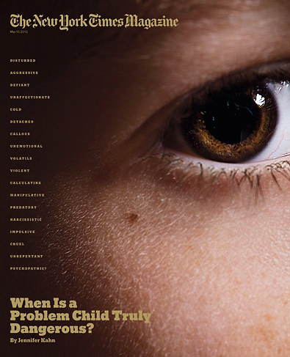
Revisions at the frontier…
Psychopathy and violence
“Where the psychopath goes, violence will surely follow”
Skeem, Polaschek, Patrick, & Lilienfeld (2011). Psych Science in the Public Interest.
Notes:
[Like LCPs, psychopaths are presumed to commit crimes because they are genetically programmed to do so. Like early onset (for LCP), CU features is a specifier for conduct disorder in the DSM (for psychopathy)]
A single measure of psychopathic personality disorder—the Psychopathy Checklist-Revised (PCL)—has become a staple of forensic assessment—mostly because it robustly predicts violence. The PCL is applied to inform legal decisions about juvenile and adult offenders that hinge on issues of dangerousness and treatability, given assumptions that it identifies qualitatively different, untreatable ‘superpredators.’
Psychopathy has been offered as a theory of violence (pseudotheory). [Click] Hare calls psychopaths “intraspecies predators who use charm, manipulation, intimidation, and violence to control others and to satisfy their selfish needs” (Hare, 1996, p. 26). They have no conscience, no capacity for empathy, and therefore nothing to keep them from preying violently on others
A growing body of research suggests that these individuals may better be conceptualized as high-risk cases. Psychopathy is not the principal driver of their offending. PCL and derivatives have helped us understand this.
-

Slide 7
Psychopathy per se has no special powers in predicting violence
PCL scores “permit the social deviance component…to be separated from the cluster of personality traits that are fundamental” to psychopathy
- R. Hare
***
*
Metanalysis: 10,055 offenders
Kenneally, Skeem, et al. (2010). Psych Assessment
Notes:
Social deviance- repeated antisocial behavior; poor anger controls; impulsive and irresponsible lifestyle
Emotional detachment – poor empathy, shallow affect, superficial charm, poor remorse—the one linked with laboratory measures of emotional processing, like poor perception of fear and emotional distress in others
Upshot: Psychopathy (and CU) have no special powers in predicting violence or other criminal behavior

Slide 8

Why has this person done these terrible things?
And how do you know he’s a psychopath?
Because he’s done these terrible things
Because he’s a psychopath
Notes:
Psychopathy isn’t a very satisfying theory of violence for high risk youth

Slide 9
Psychopathy measures actually capture multiple high-risk constellations
92%
Involved in violencewithin two years
69%
55%
Long. multimethod: N=200, M age =16 y. Kimonis, Skeem, et al. (2011). Law & Human Behav
Notes:
Although there is an assumption that psychopathy is a unidimensional disorder, theory and evidence indicates otherwise. Among those with high scores on the PCL, can identify two different high risk constellations.
Primary; Secondary. Cold/Hot. Found in multiple studies now (Swedish; NIMH; two youth). And the one we should be most concerned about isn’t the one you’d suspect with label “psychopathic.”
Upshot: Again, there isn’t “a” high risk type, even if you enter with that assumption.
Kimonis et al. – different sample; similar results. On a picture version of the dot-probe task, the low-anxious primary variant was not engaged by emotionally distressing pictures, whereas the high-anxious secondary variant was more attentive to such stimuli (Cohen d ¼ 0.71).

Slide 10
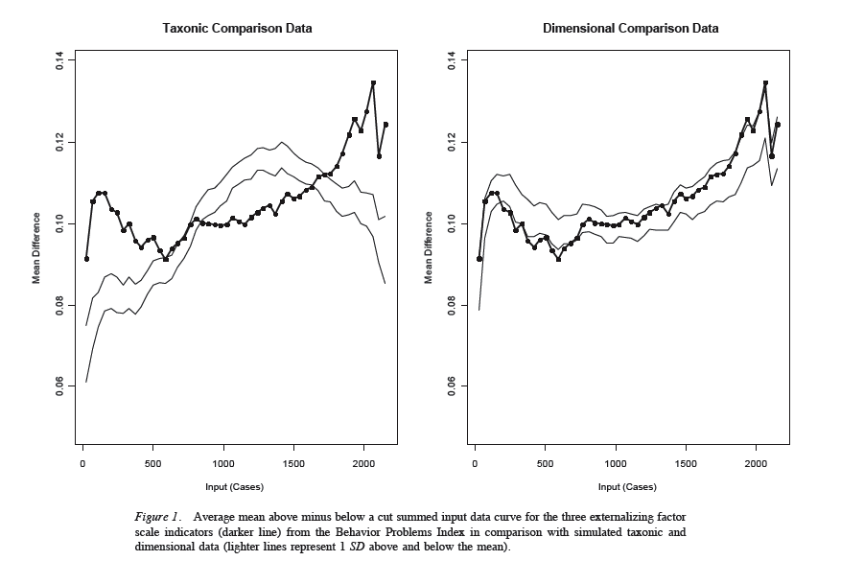
From category to dimensions
No high risk taxon(s) have been found
Aggregate risk assessments (and PCL) tap common factors
Unlike categories, dimensions provide direction for intervention
Walters (2011)
Notes:
In short, there is convergence on a need to shift from categories to continua, in defining high-risk youth. These juveniles are distinguished from others more in degree than in kind--they have a greater number and/or more serious risk factors.
There is some convergence between theoretical and applied literatures on major dimensions that are relevant to defining these youth. These can be viewed as modular building blocks that can be used to describe a given youth.

Slide 11

From category to dimensions
Common factors to target in intervention
(Socio)emotional deficits
Fear recognition
Punishment sensitivity
…
Disinhibition
Inhibitory control
Emotion regulation
…
Developmental/contextual
Stimulation seeking
Peer delinquency
Suboptimal caregiving
…
Notes:
RELEVANT DIMENSIONS
Disinhibition- deficits in inhibitory control and emotional regulation, AKA “externalizing” or “hot” conduct disorder
SE deficits – from the specific to the broad – fearlesssness, callous/unemotional; broader problems with affective processing (“cold” conduct disorder)
Contextual/developmental – peer delinquency, harsh/ineffective parenting, stimulation seeking
“deficits in the ability to inhibit behavior, to recognize fear, [and/or] to respond to punishment may be potentiated in criminogenic environments characterized by suboptimal caregiving, high levels of threat, and abundant opportunities for antisocial behavior” ( Jaffee & Odgers 2013, p. 168

Slide 12
Addressing two myths to maximize crime reduction
Myth 1: Qualitatively different
Myth 2: Untreatable
People at risk for repeated involvement in violence are a qualitatively different from people at lower risk
These high risk people cannot be effectively treated to prevent violence
Notes:
Adolescence has become a period of interest for justice, education, and public health policy over recent years. *There is speculation this is a potential “sensitive period” for social-emotional learning, given significant brain plasticity—where experience, education, and interventions powerfully shape trajectories toward adulthood.
About ¾ of talk- what I have done (part 1); rest; what we’re doing now (Part 2)
UNICEF- “age of opportunity”; Lancet commission → “new agenda for adolescent global health.” World Bank, others, investing billions in these efforts.
Why? In part, because advances in neuroscience have shown us that that this is a developmental period of enormous brain plasticity—the onset of adolescence sets off a cascade of changes in the brain and body—all of which occur within the context of enormous social changes, with an increased focus on peers, romantic relationships, and establishing one’s identity apart from that of the family.

Slide 13



Testing assumptions about treatability
There is “nothing the behavioral sciences can offer for treating those with psychopathy” (Gacono, et al., 1997)
Accountability; swift and certain sanctions
Fewer treatment resources (75:1)
Erode antagonistic bonds (respect)
Greater treatment resources (20:1)
Quas-experiment with IPTW, N=141, PCL>27; Caldwell, Skeem et al. (2006)
Notes:
Inverse probability of treatment weighting to estimate causal effect of treatment on re-arrest rates over minimum two-year followup. Rich covariate set (baseline, days incarcerated, discharge status)
Compared to TAU, the intensive treatment program involved more services (e.g., 45 programming weeks) and a different philosophy. Specifically, there was less emphasis on sanctions and more emphasis on social skill acquisition, developing conventional social bonds to displace antisocial associations and activities, and eroding antagonistic relationships with authority figures to overcome defiant attitudes.
Basic treatment philoshopy--defiant behavior can become cyclic when the defiant response to a sanction is itself sanctioned, resulting in more defiance and increasing sanctions. With each iteration, the young offender is further disenfranchised from conventional goals and values and is increasingly “compressed” into a behavior pattern that is actively and antagonistically defiant.
Minimize sanctions; respect;engage; gradually establish prosocial bonds → decompress; respect
The MJTC program attempted to keep youth involved in treatment
regardless of their behavior. Disruptive and aggressive behavior was
responded to with a priority given to providing continuous intensive
treatment. In this respect, the greatest challenge to effective treat-
ment of psychopathic individuals may be in the implementation and
management of a treatment program that addresses safety issues
without sacrificing the continuity of treatment.

Slide 14
Of ‘psychopathic’ youth, those who receive intensive treatment are much less likely to recidivate violently
IPTW estimate, intensive treatment OR=2.7, p <.01
Notes:
Prospective study of 141 serious male juvenile offenders (M PCL:YV = 27; majority > 3 violent charges)
. The intensive program yielded a benefit-cost ratio of more than 7 to 1 over the TAU group (Caldwell, Vitacco, & van Rybroek, 2006).
Too vague? What evidence? Add some description.
Similar findings in studies of adult offenders in substance abuse treatment and former patients in psychiatric treatment—psychopathy doesn’t moderate the effect of appropriate intervention on violence reduction

Slide 15
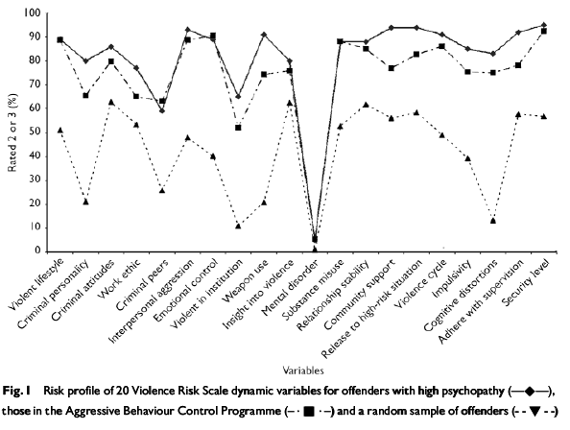
Psychopathic and high risk offenders share risk profiles and treatment needs
Intensive treatment program for high risk offenders, M PCL score > 90th percentile (Polaschek, 2007)
PCL psychopathic offenders ≈ high risk violent offenders in dynamic risk profiles (Wong, Gordon, & Gu, 2007)
Notes:
Do results generalize from psychopathy to high risk offenders? Yes, because they’re largely the same people.
Strongly (r= .77) correlated with general risk assessment measures like LSI (Edens, Campbell & Weir, 2007; Kroner, Mills & Reddon, 2005)
Kroner et al., coffee can: Tools generally capture criminal history, persistent criminal lifestyle, antisocial personality features, and alcohol/mental health problems – all predict recidivism. Newly created scales no less effective than the designed ones.

Slide 16
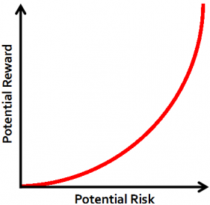
Do results generalize across treatment types?
Yes. Both branded packages and evidence-based principles “work” for high-risk people
    “there was no indication that there were juveniles whose risk level was so high that they did not respond to effective interventions”
      (Lipsey et al., 2010, p. 23)
Skeem et al., (2014). Ann Rev Clin Psychol
Polaschek & Skeem (in press). Handbook Psychopathy
Notes:
Branded packages (e.g., MST, MTFC) and generic principles (e.g., skill-building program, non-punitive philosophy, program of sufficient duration) clearly reduce criminal behavior among high-risk youths. These target disinhibition, and developmental/contextual risk factors. They vary in whether theyr target SE deficits.
This is consistent with the risk principle, and biological sensitivity models
Including those with psychopathic or CU features (but may require more intensive treatment and/or specific focus on emotions; Dadds)** SHOW NEXT SLIDE, then come back to risk principle.

Slide 17

Ample opportunity to realize the risk principle
  Those who stand to benefit most from treatment (i.e., high risk, high needs) are the least likely to receive it. (Olver et al., 2011, p. 6)
Notes:
According to recent estimates, “fewer than 5% of eligible high-risk juvenile offenders in the U.S. are treated with an evidence-based [brand-name] treatment annually” (Henggeler & Schenwald, 2011).
Even in a rehabilitation-oriented state, almost half (43%) of 57 juvenile programs failed to focus service provision (of any kind) on juveniles classified as high risk (Redpath & Brander, 2010; as cited in Lipsey et al., 2010).
IMPLICATIONS: CARVE HIGH RISK YOUTH INTO JUVENILE JUSTICE REFORM AND FOCUS INTENTLY ON TREATMENT ENGAGEMENT/RETENTION

Slide 18
From intervention to prevention: Adolescence as an age of opportunity
Explore developmentally wise interventions to nudge at-risk children’s trajectories in prosocial direction during transition to adolescence
Notes:
Adolescence has become a period of interest for justice, education, and public health policy over recent years. *There is speculation this is a potential “sensitive period” for social-emotional learning, given significant brain plasticity—where experience, education, and interventions powerfully shape trajectories toward adulthood.
About ¾ of talk- what I have done (part 1); rest; what we’re doing now (Part 2)
UNICEF- “age of opportunity”; Lancet commission → “new agenda for adolescent global health.” World Bank, others, investing billions in these efforts.
Why? In part, because advances in neuroscience have shown us that that this is a developmental period of enormous brain plasticity—the onset of adolescence sets off a cascade of changes in the brain and body—all of which occur within the context of enormous social changes, with an increased focus on peers, romantic relationships, and establishing one’s identity apart from that of the family.

Slide 19

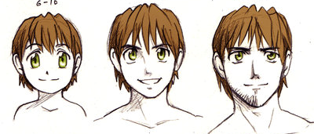
Toward developmentally “wise” early intervention
What to target…and when
Notes:
WISE INTERVENTIONS- more ordinary, brief, and precise than traditional ones. “Wise” to psychological processes that contribute to violence. Aimed to alter a specific way that kids think/feel EVERYDAY to help flourish. Target recursive processes (like interpreting ambiguous situatiosn as threatening; which can compound over time) to cause lasting change…and for that reason may be especially impactful during key periods of development.
Consensus priorities
Focusing on period around transition from childhood to adolescnece
Theoretically, period of socio-emotional learning
Complements 0-5 (neuro_) AND juvenile justice (implementation) efforts
Moderate-risk children & adolescents
Strengths-based (building on real capacities)
“Light-touch” interventions
Especially interested in neurodevelopmental processes that may create modifiable inflection points during childhood and/or early adolescence

Slide 20
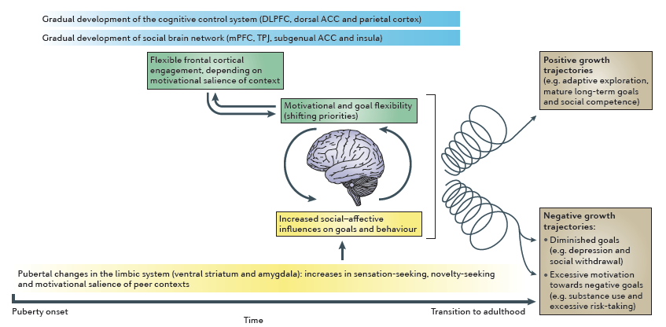
Transition to adolescence as period of social-affective engagement & goal flexibility
Pfeifer & Berkman (2018): engagement of vmPFC may facilitate & reflect identity development by integrating across sources of value, including self- and social related rewards
Crone & Dahl (2012)
Notes:
As summarized by Crone & Dahl (2012), this developmental transition marks the beginning of dramatic changes in reward processing, status seeking, and social-affective learning. The onset of adolescence sensitizes youths to their social world and creates tendencies to explore and engage. Although these tendencies confer vulnerability to risk-taking behavior (including crime), they also appear to offer adaptive advantages, including a greater capacity for social and affective learning than adults have. This includes learning about trust, empathy, and patterns of automatic behavior in response to specific emotional and social cues. This is also a period of wicking passions that can last a lifetime.
For at-risk youth, early adolescence could provide a natural inflection point for promoting prosocial motivation and goals and IDENTITY.
Pfeifer & Berkman (2018)- activated identity can increase the value of goal-directed behavior when seen as relevant to the identity
We’ve begun to address some of the questions in our research agenda. When are youth most developmentally prepared for and sensitive to particular types of intervention? Two examples.

Slide 21

Goal: Inform policy-level violence prevention
Notes:
Not just focused on modifying individual psychological processes—also substantial room for modifying context
Yeager- middle adolescence as a period of sensitivity to admiration/respect; want to be treated like adults. Why standard bullying programs may have less impact for these groups. Intervention: respect.
(Okunufa; empathy training for teachers (35 teachers; over 1200 students)—consider backstories/reasons for misbehavior) → .
found that previously-suspended students whose teachers had completed the empathy training intervention reported that their classrooms were now more respectful.
Also--students in classrooms with treated teachers also showed half as many suspensions in school (from 9% of students to 4.5%), and not just in the classrooms where they had a treated teacher. Students responded to greater respect by following school rules
GOAL: Not to develop new intensive interventions; instead, to identify feasible *principles* of timed intervention that could have large-scale impact;

Slide 22
Core Message & Practice Recommendations
High risk, not hopeless
High risk, not hopeless clients
Stay the course. Engage, engage, engage. Be firm, fair and caring.
Prioritize high-risk clients for evidence-based practices
Target robust risk factor dimensions to reduce risk
Notes:
This is an unprecedented opportunity to make a difference in high risk offenders’ lives while improving public safety
High risk youth for implementing evidence based practices to maximize crime reduction
Common factors as building blocks to target for risk reduction [socioemotional deficits; disinhibition; threatening or nonsupportive contexts)

Slide 23







Contact & Funding Support
Jennifer L Skeem, PhD
jenskeem@berkeley.edu
risk-resilience.berkeley.edu/

Slide 24
Skeem & Polaschek (in press)
“High risk, not hopeless”
Intensive treatment reduces ASB for juveniles with CU

