Slide 1
Case Law Update
John Van Lieshout

Slide 2
Hoffer Properties, LLC v. DOT, 366 Wis. 2d 372

Slide 3
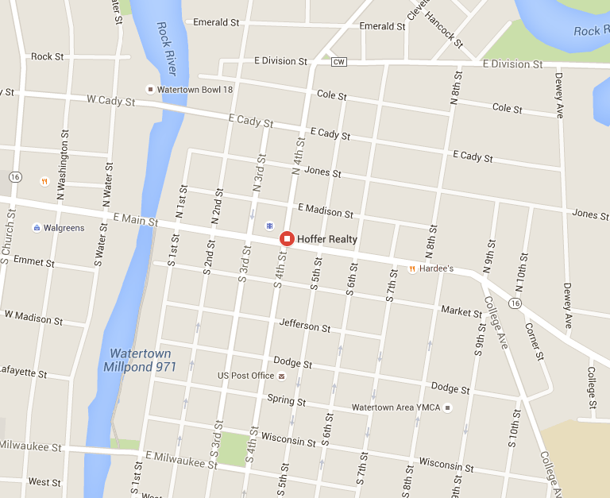

Slide 4
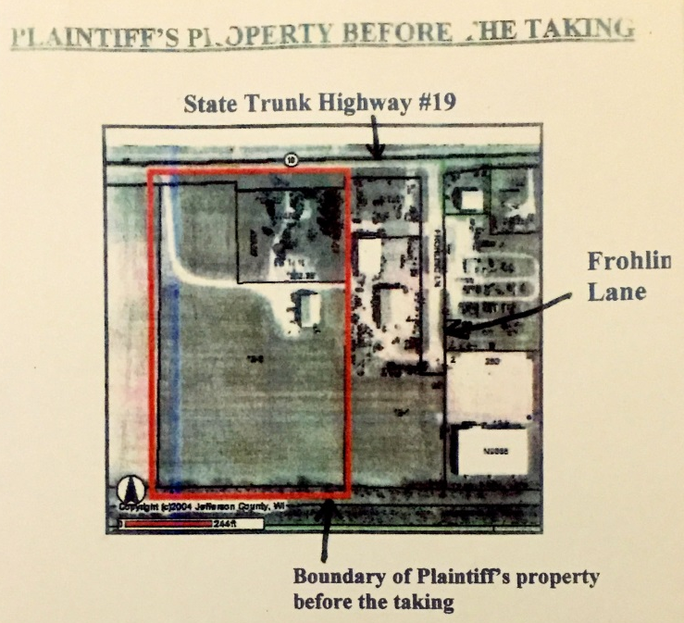

Slide 5
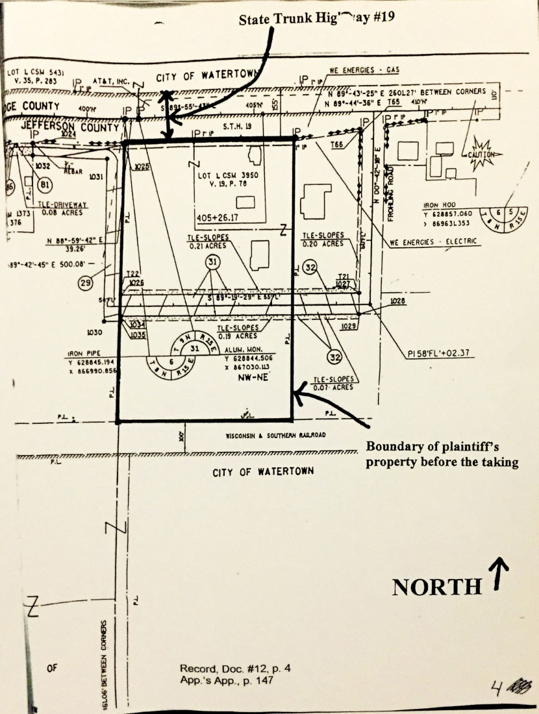

Slide 6
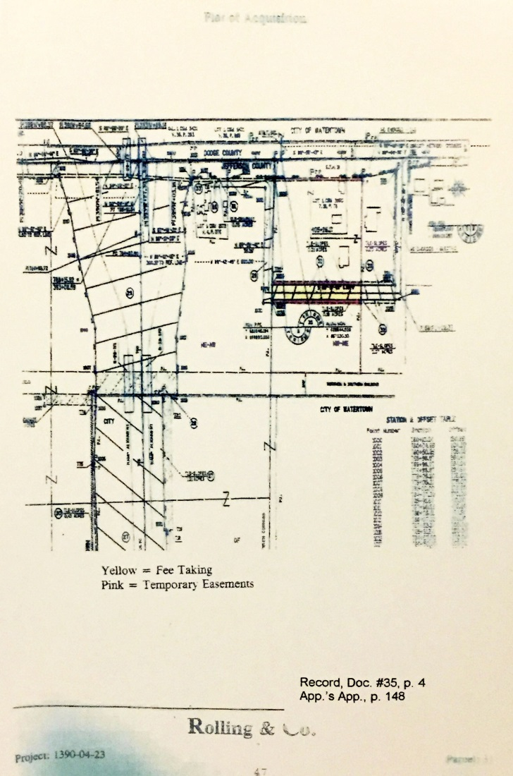

Slide 11
Murr v. Wisconsin, 359 Wis. 2d 675 (Wis. App 2014)

Slide 12
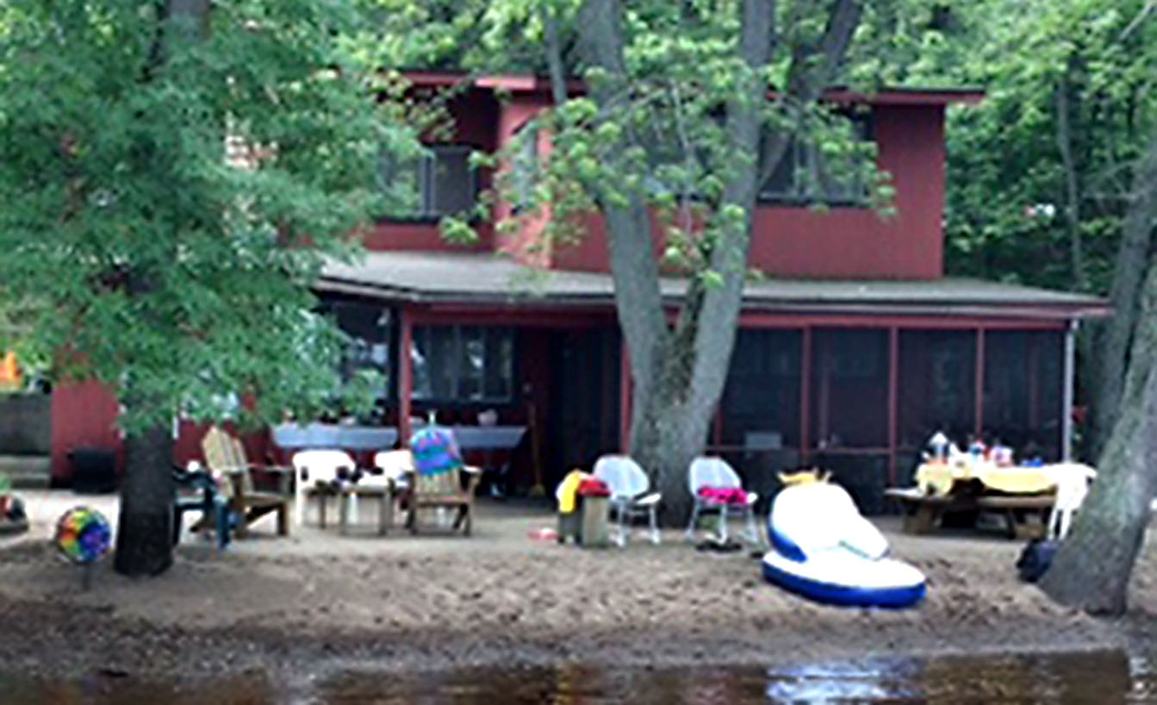

Slide 13
NDC, LLC v. WDOT, 366 Wis. 2d 809 (2015)

Slide 14
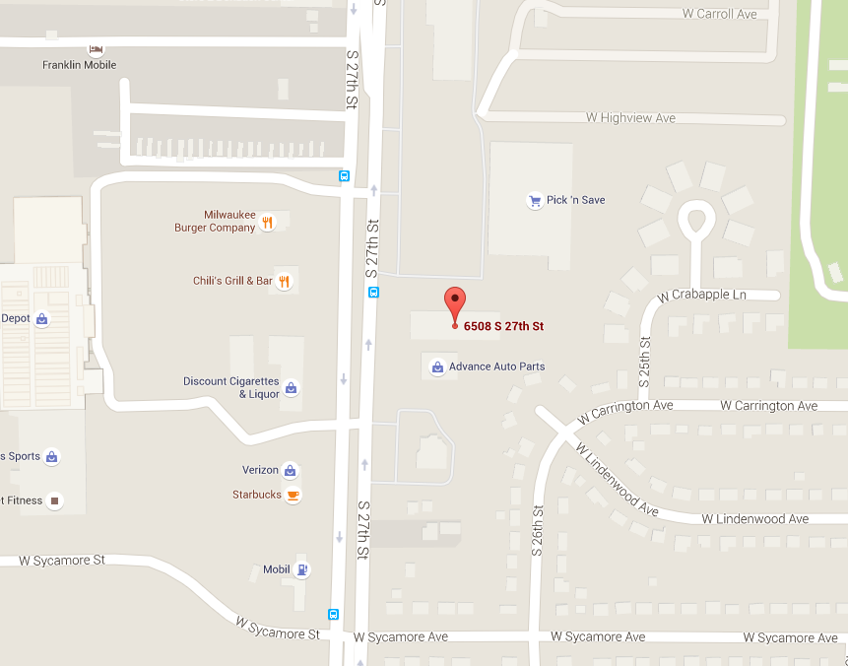

Slide 15
Lee v. WDOT, 365 Wis. 2d 195 (2015)

Slide 16
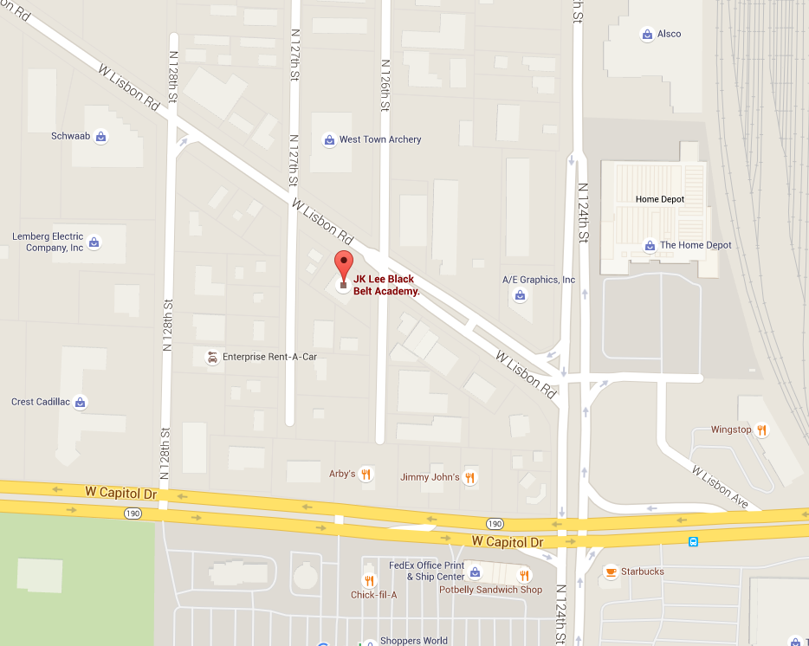

Slide 19
Hoeft v. City of Beaver Dam, 364 Wis. 2d 528 (2015)

Slide 20
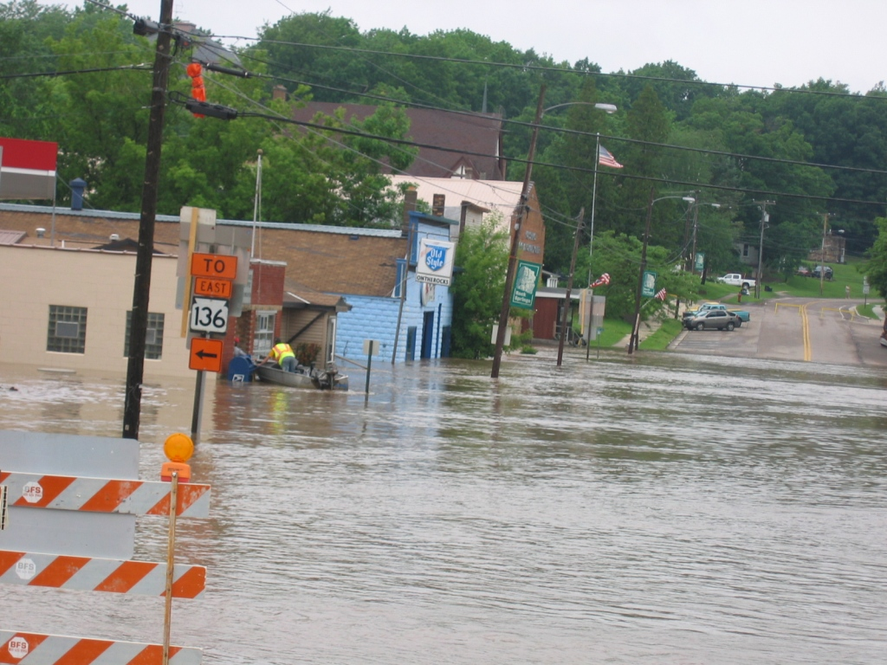

Slide 21
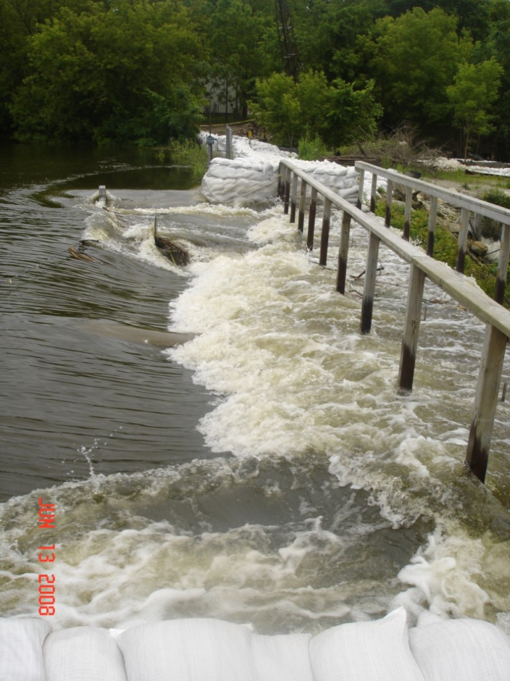

Slide 23
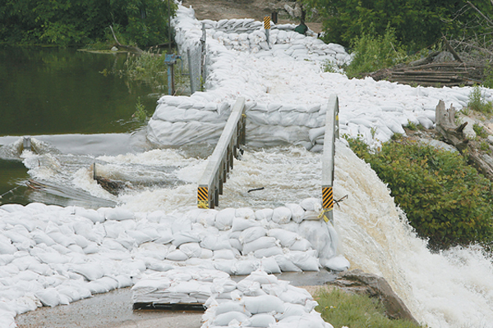

Slide 24
