Slide 1
Environmental Clean Up Costs in Condemnation Actions
Howard Roston, Esq.
Fredrikson & Byron, P.A.
200 South Sixth Street, Suite 4000
Minneapolis, MN 55402
Direct Dial 612.492.7441
hroston@fredlaw.com
www.fredlaw.com

Slide 2
The Problem
The lawyer’s duty.
A lawyer is an advocate. A lawyer Is to zealously advocate for his or her client within the bounds of the law. See American Bar Association, Model Rules of Professional Conduct; Preamble and Scope.
In a condemnation case, a lawyer argues for just compensation which may or may not be the same as fair market value.
The appraiser’s duty.
An appraiser is obligated to value property in a manner that is impartial, objective and independent. The Appraisal Foundation Appraisal Standards Board, Uniform Standards of Professional Appraisal Practice (“USPAP”), Ethics Rule
USPAP makes it clear that an Appraiser may not be an advocate for a client. However, once the appraisal is complete, the appraiser may defend the appraisal and advocate for the opinion.

Slide 3
The Appraiser’s Opinion of Value is Independent of the “Purpose of the Appraisal”
An appraiser must not allow the intended use of the appraisal or the client’s objective to result in bias.
USPAP Standards Rule 1-2 Comment
Market value is market value, regardless of the “purpose” of the appraisal.

Slide 4
Assumptions and Hypotheticals in Litigation
Remember that a lawyer is an advocate.
A lawyer’s job is to either support or refute the overall opinion.
One way to do that is to discuss the assumptions and hypotheticals.
The theme: “Garbage in, Garbage out.”

Slide 5
Assumptions and Hypotheticals
Extraordinary Assumption
Hypothetical Condition
An extraordinary assumption may be used in an assignment only if:
It is required to develop credible opinions and conclusions;
The appraiser has a reasonable basis for the extraordinary assumption;
Use of the extraordinary assumption results in a credible analysis; and
The appraiser complies with the disclosure requirements set forth in USPAP for extraordinary assumptions.
A hypothetical condition may be used in an assignment only if:
Use of the hypothetical condition is clearly required for legal purposes, for purposes of reasonable analysis, or for purposes of comparison;
Use of the hypothetical condition results in a credible analysis; and
The appraiser complies with the disclosure requirements set forth in USPAP for hypothetical conditions.

Slide 6
Typical Appraisal Limiting Conditions
“The appraiser is not aware of the presence of soil contamination on the subject property unless otherwise noted in this appraisal report. The effect upon market value, due to contamination was not considered in this appraisal, unless otherwise noted.”

Slide 7
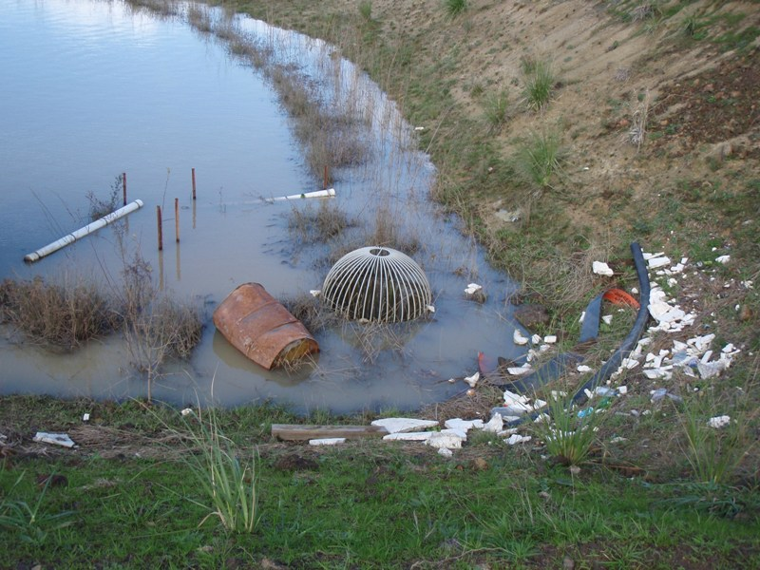
What if this is the “subject property?”

Slide 8
In Describing the Scope of the Work, The Appraiser Cannot be Misleading.
An appraiser cannot make extraordinary assumptions or adopt hypothetical conditions that are unreasonable or biased. USPAP, at its core, requires that an appraisal not be misleading. Both definitions require credibility.
Examples:
The appraiser cannot assume the highest and best use of the property is to drill for oil by simply stating, as an extraordinary assumption, that there is oil under the subject property.
However, in the Bakken basin in North Dakota, armed with geological reports on neighboring property, the appraiser could possibly make the same assumption.
The appraiser must require support for assumptions. The lawyer should be prepared to provide objective support if requesting the extraordinary assumption.

Slide 9
Further Resources (Attached)
USPAP Advisory Opinion 9 (AO-9)
Appraisal Institute® Guide Note 6 – Consideration of Hazardous Substances in the Appraisal Process.

Slide 10
It is unconstitutional to offset environmental clean up costs from just compensation?
Both the United States Constitution and the Wisconsin Constitution require Just Compensation. “Just Compensation” is typically described as “Fair Market Value.” However, the two concepts are not synonymous.
Because just compensation was “inserted for the protection of the citizen, it ought to have liberal interpretation, so as to effectuate its general purpose.” Citing Adams v. Chicago, Burlington & N.R.R., 39 N.W. 629 (1888).

Slide 11
Just compensation replaces money for property.
The United States Constitution requires that when the government condemns property, it must put a property owner “in as good a position pecuniarily as if his property had not been taken.” Olson v. United States, 292 U.S. 246, 255 (1934).
The federal and state constitutions generally do not prohibit the taking of private property for public use but rather "place[] a condition on the exercise of that power.” Lutheran Church of Glendale v. Cnty. of Los Angeles, Cal., 482 U.S. 304, 314 (1987)). Namely, the government must justly compensate the property owner for the taking. See id. at 537.

Slide 12
Competing Jurisdictions
Inclusion
Exclusion
260 North 12 Street, LLC v. State of Wisconsin Dept. of Trans., 808 N.W.2d 372 (Wis. 2011);
Redev. Agency of Pomona v. Thrifty Oil Co., 5 Cal.Rptr.2d 687 (Cal.Ct.App.1992);
Ne. Conn. Econ. Alliance, Inc. v. ATC P'ship, 776 A.2d 1068, 1080 (Conn.2001);
City of Olathe v. Stott, 861 P.2d 1287 (Kan.1993);
Silver Creek Drain Dist. v. Extrusions Div., Inc., 663 N.W.2d 436 (Mich.2003);
Dep't of Transp. v. Hughes, 986 P.2d 700 (Or.Ct.App.1999); Tennessee v. Brandon, 898 S.W.2d 224 (Tenn.Ct.App.1994);
Finkelstein v. Dep't of Transp., 656 So.2d 921, 922 (Fla.1995)
Moorhead Econ. Dev. Auth. v. Anda, 789 N.W.2d 860 (Minn. 2010);
Dep't of Transp. v. Parr, 633 N.E.2d 19 (Ill.App.Ct.1994);
Aladdin, Inc. v. Black Hawk Cnty., 562 N.W.2d 608 (Iowa 1997);
Hous. Auth. of New Brunswick v. Suydam Investors, LLC, 826 A.2d 673 (N.J.2003);
City of New York v. Mobil Oil Corp ., 12 A.D.3d 77 (N.Y.App.Div.2004).

Slide 13
Competing Policies
Policies Favoring Exclusion:
Fairness to the property owner who did not ask to be condemned.
Risk of double-liability for the property owner.
Owner is not always the “responsible party.”
There are clean-up resources that an owner may be able to take advantage of in the marketplace.
Admitting this evidence is not “just.”
Comparable sales are “hard to find.”
Policies Favoring Inclusion:
Marketplace would consider
contamination.
Government should not pay more than the marketplace.
Concern over a “fictional property value.”
No different than valuing damaged property such as property with a defective roof.

Slide 14
Is this really a highest and best use issue?
In reality, the value of property (even contaminated property) depends on its highest and best use.
Gas stations are almost always contaminated and always trade. The marketplace simply understands this and accounts for it.
Contamination under a surface parking lot may or may not be considered in the marketplace. Is the property going to be developed or will it continue as a surface parking lot?

Slide 15
Should the Law Dictate Appraisal Methodology?
In CSX Trans., Inc. v. Georgia State Bd., 552 U.S.9 (2007). The Petitioner challenged the tax assessment and argued, in part, that the State appraiser’s methodologies were flawed. The State asserted that the railroad was powerless to challenge the methods employed by the State’s appraiser and could only challenge the application of the methods. Both the District Court and a divided Court of Appeals for the Eleventh Circuit agreed. The United States Supreme Court reversed. According to the United States Supreme Court:
Given the extent to which the chosen methods can affect the determination of value, preventing courts from scrutinizing state valuation methodologies would render § 11501 a largely empty command. It would force district courts to accept as “true” the market value estimated by the State, one of the parties to the litigation. States, in turn, would be free to employ appraisal techniques that routinely overestimate the market worth of railroad assets. By then levying taxes based on those overestimates, States could implement the very discriminatory taxation Congress sought to eradicate. On Georgia’s reading of the statute, courts would be powerless to stop them, and the Act would ultimately guarantee railroads nothing more than mathematically accurate discriminatory taxation. We do not find this interpretation compelling. Instead, we agree with Judge Fay in dissent below: “Since the objective of any methodology is a determination of true market value, a railroad should be allowed to challenge the method[s] used [by the State] in an attempt to prove that the result ... was not the true market value of its property.” 472 F.3d, at 1294.
The United States Supreme Court also noted that the methods of valuation employed by an appraiser are selected by the choice of an appraiser and not the dictate of any statute or regulation. Id.

Slide 16
Notes

