Slide 1
INVERSE
CONDEMNATION
S. Steven Vitale, MAI
svitale@valbridge.com
262-782-7990
valbridge.com

Slide 2
ESREVNI
NOITANMEDNOC

Slide 3
Inverse Condemnation vs. Eminent Domain
Eminent domain refers to the legal proceeding in which government asserts its authority to condemn property and property owners receive just compensation.
Inverse condemnation is applied when a property owner recovers just compensation for a taking of his property when no condemnation proceedings have been applied.
As a general rule, any sort of physical impact to a property is more easily identified as a taking with normal condemnation proceedings will occur.
Notes:
Note Nick provided a few examples already.

Slide 4
Inverse Condemnation
Inverse condemnation matters usually involve regulatory takings, which are less obvious than a traditional physical taking or invasion of use.
Actual inverse condemnation cases are fairly rare. And most property owners lose their cases.
The burden of proof falls on the landowner. Every regulation has a presumption of validity unless the challenger proves that the legislation or action is unconstitutional or illegal.

Slide 5
Inverse Condemnation
The most common defense of an inverse condemnation argument is that the action is not compensable. For example, the closing of an access point or median cut or anything that significantly changes traffic flow may be argued to be a proper exercise of police power and, therefore, is generally not compensable.
The courts consider whether the action would “force some people alone to bear public burden which, in all fairness and justice, should be borne by the public as a whole.”
In other words, does the cost of an action get unfairly applied to a single party?

Slide 6
Types of Regulatory Takings
Government’s “physical” occupation or invasion of an owner’s property
Examples of Physical Invasion:
Cable television installed a ½ inch cable 30 feet in length and two silver boxes along the roof cables.
The frequent and regular flights of the government’s low-flying aircraft over the property owner’s land destroyed the property’s use as a chicken farm, and was a taking within the meaning of the Fifth Amendment.
Notes:
Most physical occupations are regular takings.

Slide 7
Types of Regulatory Takings
Government’s “physical” occupation or invasion of an owner’s property
Government action that deprives the owner of all economically beneficial use of property
One example of an inverse condemnation claim that lost involved the banning of commercial air traffic in downtown Washington DC. The FAA banned all commercial air traffic nationally following the terrorist attacks of September 11, 2001. The FAA extended the ban permanently to cover much of the airspace in Washington DC. This forced Air Pegasus to shut down a heliport. Air Pegasus lost its claim alleging a regulatory taking of its property. Courts decided the navigable airspace is part of the public domain and that Air Pegasus had no property interest in that airspace. Therefore, there was no taking requiring just compensation.

Slide 8
Types of Regulatory Takings
Government’s “physical” occupation or invasion of an owner’s property
Government action that deprives the owner of all economically beneficial use of property
Government action that, under the fact-based inquiry of Penn Central Transportation Company vs. City of New York, otherwise economically burdens the property owner, including investment-backed expectation, and the nature of the government action effects a taking
Notes:
Had plans to build high rise office building over train station, but train station had been designated an historic landmark.

Slide 9
Types of Regulatory Takings
Government’s “physical” occupation or invasion of an owner’s property
Government action that deprives the owner of all economically beneficial use of property
Government action that, under the fact-based inquiry of Penn Central Transportation Company vs. City of New York, otherwise economically burdens the property owner, including investment-backed expectation, and the nature of the government action effects a taking
“Land use expectation,” whereby the government conditions a permit or other approval on the owner’s agreement to dedicate all or part of its property to a public use.

Slide 10
Regulatory Taking Examples
Being denied a development approval
Being denied a building permit
Rezoning denials
Denial of conditional use permit
Denial of liquor license
Rezoning of neighboring properties that may negatively impact adjacent or nearby properties
Development permit conditions
Denial to fill wetlands

Slide 11
Regulatory Limits?
In 1922, Supreme Court Justice Oliver Wendall Holmes Jr. said “The general rule, at least, is that while property may be regulated to a certain extent, if regulation goes too far it will be recognized as a taking.”

Slide 12
BUT WHAT IS TOO FAR?
The best the Court has been able to clarify that rule is to identify two sets of factors:
The economic impact of the regulation, its interference with reasonable investment backed expectations, and the character of the governmental action.
The application of a general zoning law to a particular property effects a taking if the ordinance does not substantially advance legitimate state interests … or denies an owner economically viable use of his land.
Notes:
I find it interesting that they use terms directly related to financial expectations when we are always taught the Income Approach is not to be used in condemnation appraisals.

Slide 13
Appraisal Issues
1
The overall appraisal process and analysis in an inverse condemnation is essentially the same as a regular condemnation appraisal.
Date of value an important question. There is no acquisition date. The date of value is the beginning of the project or regulatory impact.

Slide 14
Appraisal Issues
2
When appraisers get contacted to do an inverse condemnation appraisal, they do not need to form an opinion as to whether a compensable taking has taken place.
Appraisers should limit their work to the “simple” task of estimating the value of the property before the alleged taking and after the government action.

Slide 15
Appraisal Issues
3
Inverse condemnation actions are generally a long, drawn out process. Lawyers may get appraisers involved early to get an opinion or estimate of the amount of potential damages.
The actual appraisal may or may not be ordered immediately as they may first have hearings to determine whether the event qualifies as an inverse condemnation and a compensable damage has occurred.

Slide 16
Appraisal Issues
4
Inverse condemnation damages are often viewed as a temporary rather than a permanent damage.
The measure of compensation is the owner’s loss, not the taker’s gain; essentially the same as a temporary easement.
“A landowner has no right to insist a temporary taking be deemed a permanent taking.”
As such, many inverse condemnation cases are treated as temporary takings.

Slide 17
Appraisal Issues
5
In temporary takings, the Court rules the constitution requires that the government pay the landowner for the value of use of the land during the temporary period.
The diminution in value resulting from a temporary taking is usually based on the economic rent of the affected for the term of the temporary taking. Measurement is often similar to a Temporary Easement or TLE.

Slide 18
Appraisal Issues
6
Just compensation is assumed to be paid as of the date of taking in one lump sum.
However, rent (or an appropriate return) would be paid periodically over the term of the lease (or project).
The appraiser must convert the rental payments lost due to the temporary taking into a lump sum value as of the date of taking.

Slide 19
Severance Damages
Per Eaton, severance damages are the “diminution of the market value of the remainder, in the case of a partial taking, which arise (a) by reason of the taking (severance) and/or (b) the construction of the improvement in the manner proposed.”
Appraisal Institute Dictionary of Real Estate says severance damages are “generally used to mean those damages to a remainder property that are compensable.”
WI Jury instructions state “Severance damages reduce the fair market value of the remaining property because of the partial taking.”

Slide 20
Example of Inverse Condemnation Claim
Development of new multi-family apartments will negatively impact value of adjacent new single family residential subdivision.
Difficult to prove due to abundance of examples of adjacent land uses with single and multi-family uses.

Slide 21
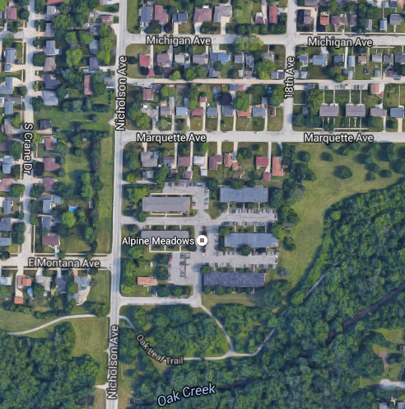
Oak Creek Nicholson Ave.

Slide 22
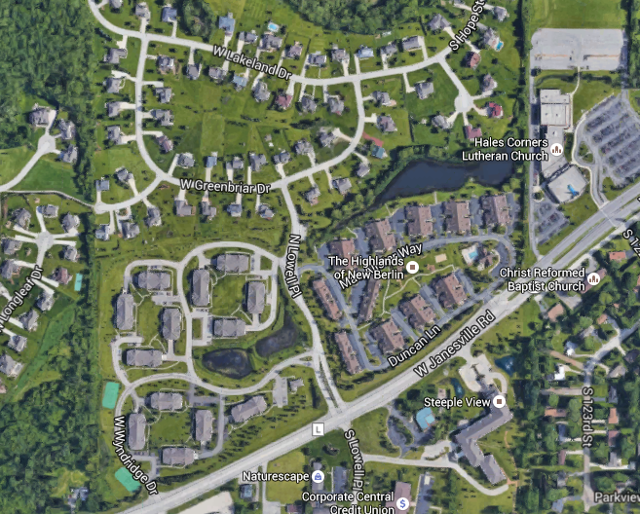
New Berlin – Janesville Road

Slide 23
New Berlin – NWQ Calhoun/Lincoln

Slide 24
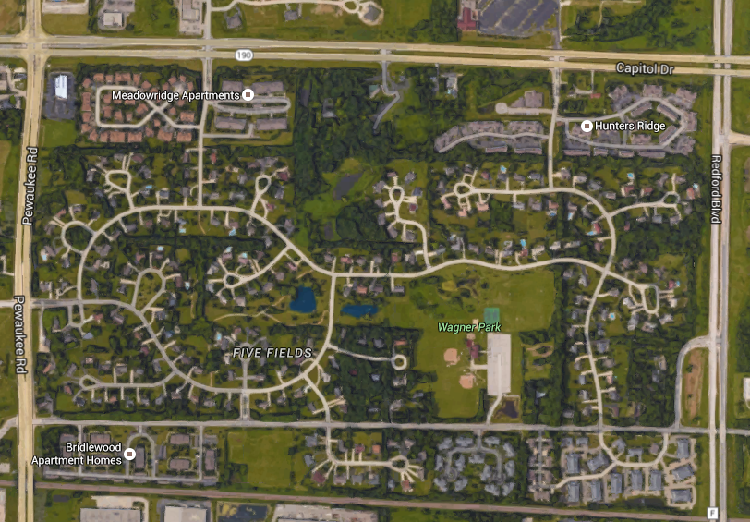
Pewaukee – Five Fields Capitol Drive/Hwy. F

Slide 25
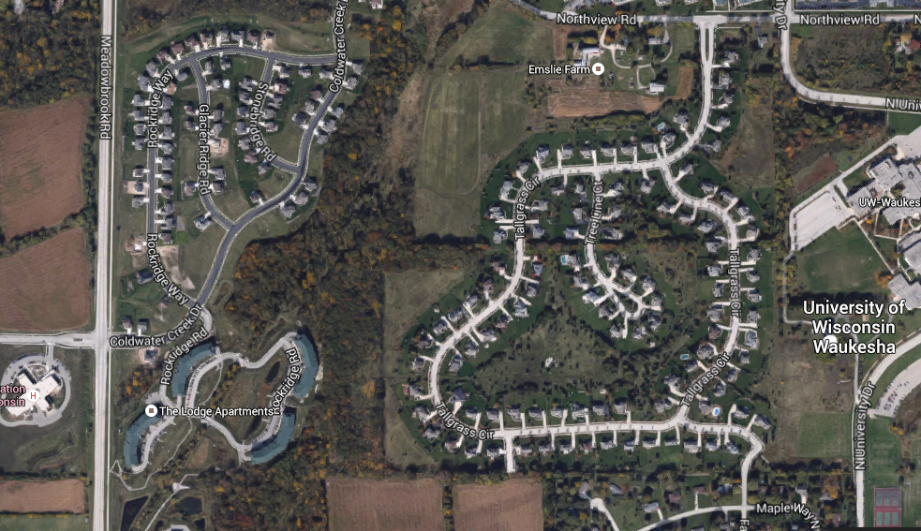
Waukesha Meadowbrook Road

Slide 26
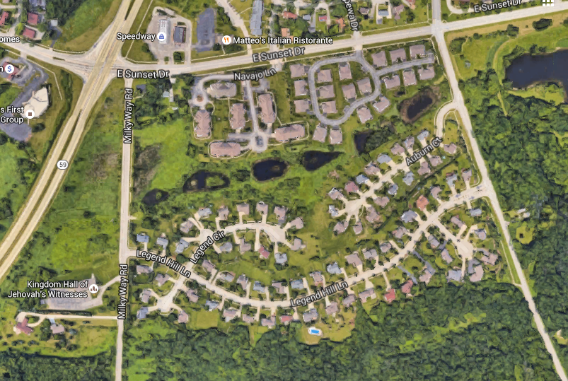
Waukesha Hwy. 59/Sunset

Slide 27
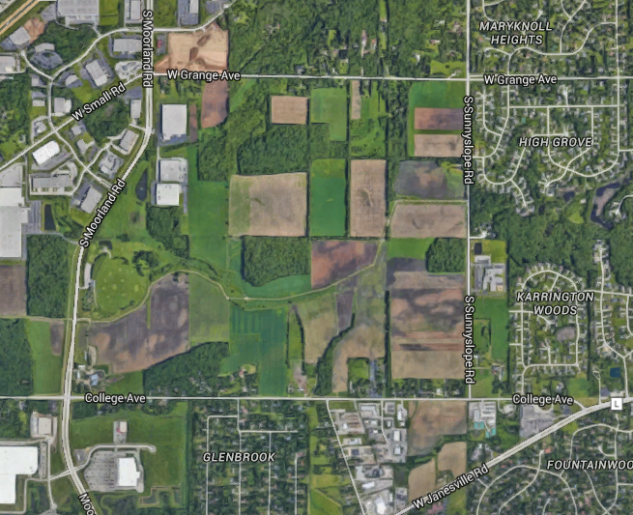
New Berlin Plan Calls for Mixed Use

Slide 28
EHT DNE!
S. Steven Vitale, MAI
svitale@valbridge.com
262-782-7990
valbridge.com

